Slide 1
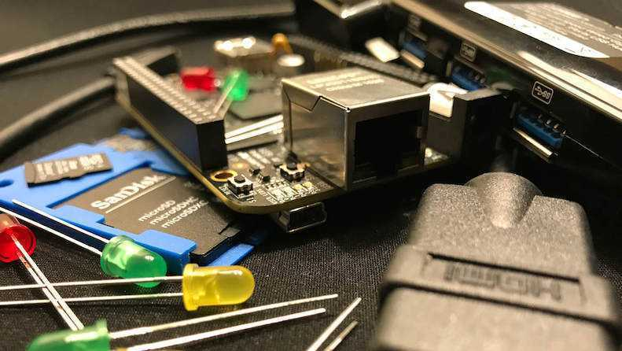


PocketBeagle TechLab Workshop

Slide 2

PocketBeagle walk-through
Friendly to novices and experts alike, the Beagle experience tracks mainline u-boot, Linux and Debian development, while augmenting it to enable development to start as quickly as possible. Attendees will get started interacting with the hardware via the command-line, shell scripts, Python and JavaScript. Attendees will be walked through the configuration details for the boot configuration, pin multiplexing, USB networking and other helper scripts they should get to know. Support and development processes within the BeagleBoard.org community will be covered. Exercises will pave the way for the other workshops to dive into their topic without needing to backtrack excessively on PocketBeagle-specific details.

Slide 3
Author and license
Author
Jason Kridner Co-founder BeagleBoard.org, Texas Instruments Sitara apps https://beagleboard.org/about
License
Creative Commons Attribution – Share Alike 4.0 https://creativecommons.org/licenses/by-sa/4.0/

Slide 4
Outline
BeagleBoard.org, PocketBeagle and BaconBits
Developer experience
Command-line and shell script
JavaScript and Python
C/C++
C on PRUs
Project examples
Labs

Slide 5
BeagleBoard.org’s objectives
Education
Design and use of open source SW/HW
Embedded computing
Collaboration
Physical computing
Robotics
Industrial/machine controls

Slide 6
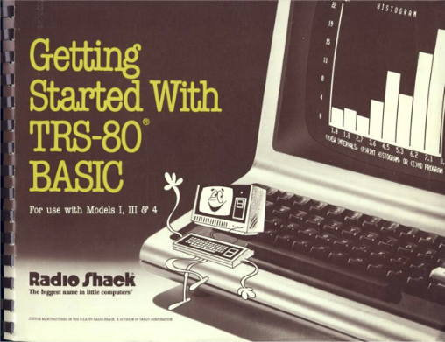
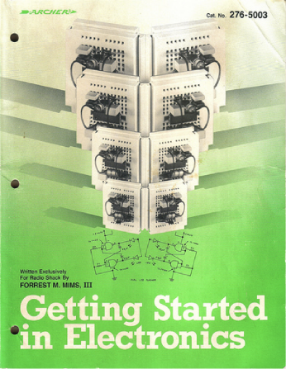
Inspiration from early PCs
http://newcome.wordpress.com/2009/12/15/make-electronics-the-new-engineers-notebook/
http://www.sandywalsh.com/2012_07_01_archive.html

Slide 7
Inspiration from early PCs
How do people learn about embedded computers with so much ground to cover?
http://newcome.wordpress.com/2009/12/15/make-electronics-the-new-engineers-notebook/
http://www.sandywalsh.com/2012_07_01_archive.html

Slide 8
Inspiration from early PCs
How do people learn about embedded computers with so much ground to cover?
Linux keeps history
Affordable -> hackable
Open from boot
High-level languages
Motivate with hardware
http://newcome.wordpress.com/2009/12/15/make-electronics-the-new-engineers-notebook/
http://www.sandywalsh.com/2012_07_01_archive.html

Slide 9



Vision

Slide 10
Vision
Creating with electronics should be as easy as creating a web page

Slide 11
Vision
Creating with electronics should be as easy as creating a web page
Appliances are better than applications

Slide 12
Vision
Creating with electronics should be as easy as creating a web page
Appliances are better than applications
Open source software and hardware enable
Collaboration on the problem
Ability to understand and improve the fundamentals

Slide 13
Reality
Boot-to-browser feels too limiting → booting to Debian distro
Collaborative programming still complex → collaborate at the kernel
Many possible development environments
command-line/ssh, Cloud9 IDE, node-red, pureData, SuperCollider, LabView, Matlab, Eclipse, Visual Studio, Scratch, Blockly
Domain specific approaches
Machinekit/LinuxCNC, PLC, many IoT toolkits
Many rapid sensor approaches: capes, mikroBus, Grove/Grove Zero, PMOD
Many rapid build approaches: LEGO, printing/milling, Makeblock, Vex, various other aluminum kits

Slide 14
Approach
Don’t try to boil the ocean
We seek to engage the open source community
Help where we can
Blue supports Grove cables
PocketBeagle supports mikroBus click pinout
Many “BeagleBoard Compatible” devices targeting specific application areas

Slide 15

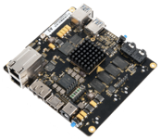
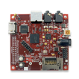
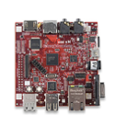
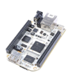
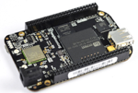
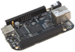
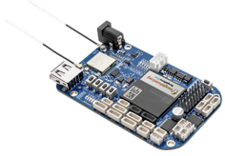
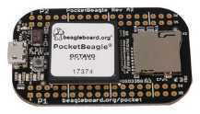
Board history
Fanless open computer (BeagleBoard)
$249
Mint tin sized with industrial peripherals (BeagleBone)
$50-70
Application focused BeagleBones
$79
Smalls mint tin sized with super-flexible design - PocketBeagle
$25

Slide 16
PocketBeagle objectives
Get simple
4-layer PCB done in both Kicad and EAGLE
Every expansion header pin has a useful predefined mode
Get flexible
USB to holes, no on-board pin consumption, no header soldered
Support for 2 mikroBus Click boards (over 300 already exist)
Get small
Stick with mint-tin survival-kit theme, but go to “smalls” (35mm x 55mm)
Get low cost
System-in-package approach has can lower build costs
Launched/sustainable at $25

Slide 17
PocketBeagle key features
Processing
1-GHz ARM Cortex-A8 processor
2x200-MHz programmable real-time units (PRUs)
ARM Cortex-M3 microcontroller for power and security
SGX530 graphics processor (OpenGLES)
Memory
512-MB DDR3
4-KB I2C EEPROM
Interfaces
USB 2.0 OTG
microSD
72 expansion header pins
8 analog inputs (6@1.8V, 2@3.3V)
44 digital I/Os (18 enabled)
3 UARTs (2 enabled)
2 I2C ports
2 SPI ports
2 quadrature encoders accessible
2 CAN bus controllers accessible
USB, power/reset buttons, battery/DC

Slide 18
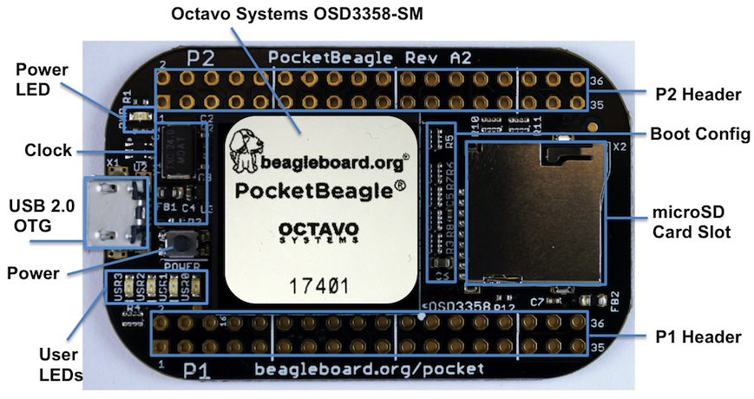
PocketBeagle top

Slide 19
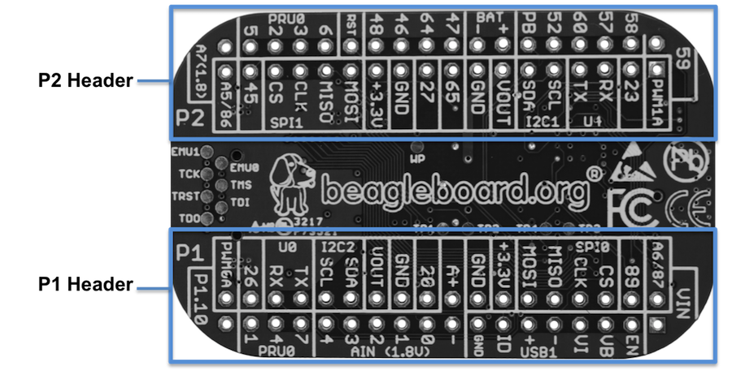
PocketBeagle bottom

Slide 20
PocketBeagle bottom
44

Slide 21
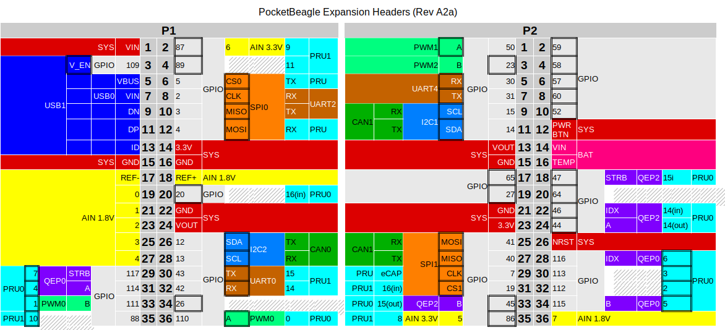
PocketBeagle expansion

Slide 22
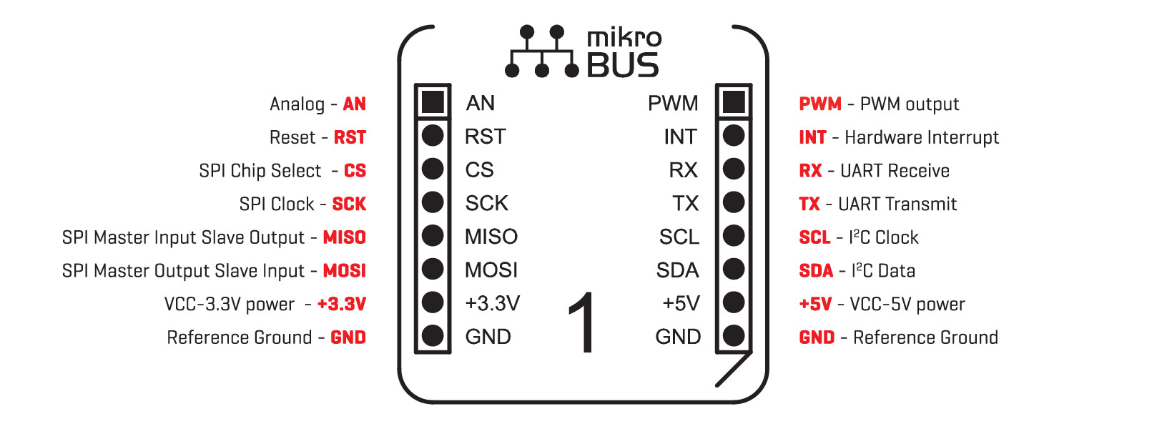
mikroBus Click

Slide 23
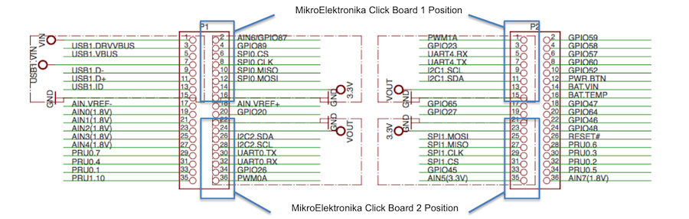
Connecting mikroBus Clicks

Slide 24
TechLab objectives
Designed specifically for e-ale training
Inspired by “Bacon Cape” by Dave Anders
Designed for similar purpose on BeagleBone
Migrated to PocketBeagle as “BaconBits” by Michael Welling
Updated to have mikroBus header and made “pretty”
Extra button (with PRU option), light sensor rather than potentiometer
Provides target for common embedded interfaces
SPI, I2C, GPIO, PWM, ADC, USB, serial
Avoid users needing to buy several modules

Slide 25
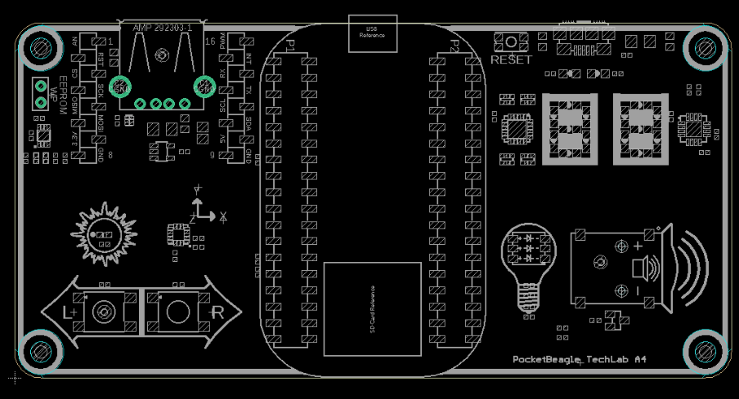
TechLab features
USB-to-Serial micro B
USB Host A with power
Reset button
2 GPIO push buttons (L and R)
ADC light sensor
PWM tri-color LED
SPI 2-digit 7-segment display
I2C accelerometer
mikroBus header

Slide 26
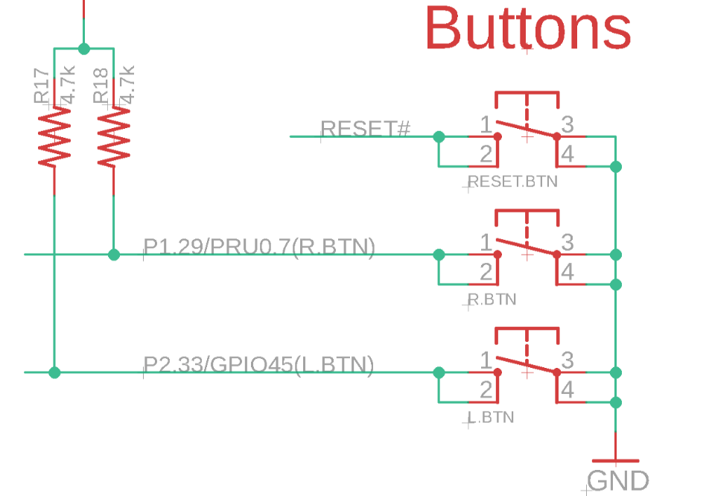
TechLab GPIO inputs

Slide 27
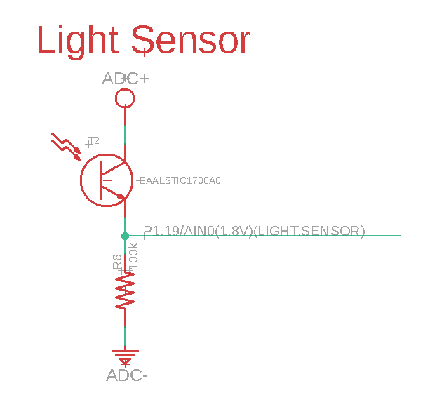
TechLab ADC input

Slide 28
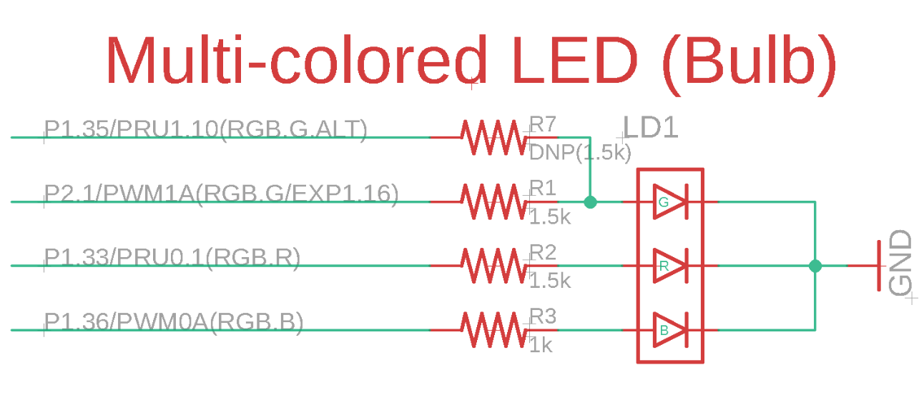
TechLab PWM output

Slide 29
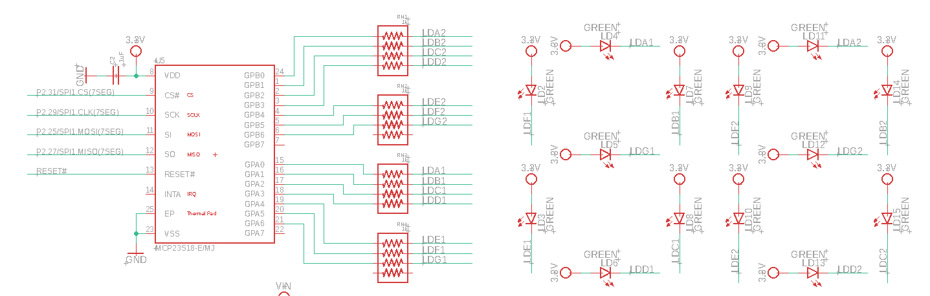
TechLab SPI 7-segment display

Slide 30
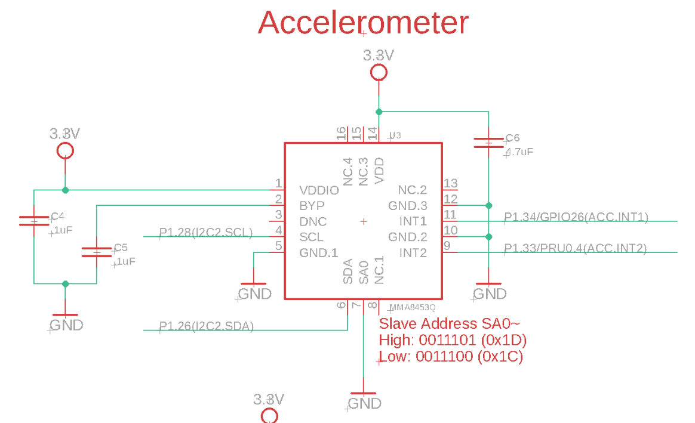
TechLab I2C sensor

Slide 31
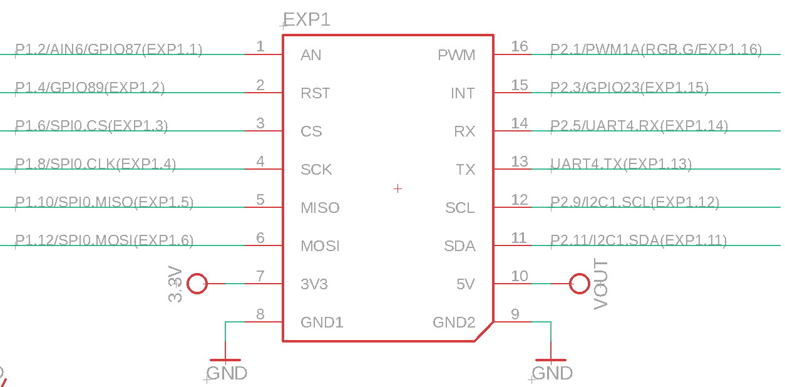
TechLab mikroBus header

Slide 32
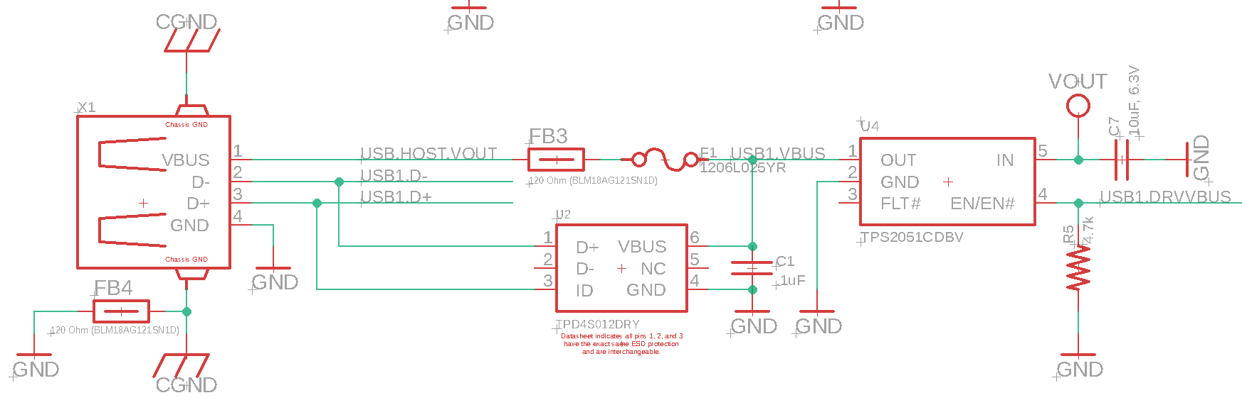
TechLab USB host

Slide 33
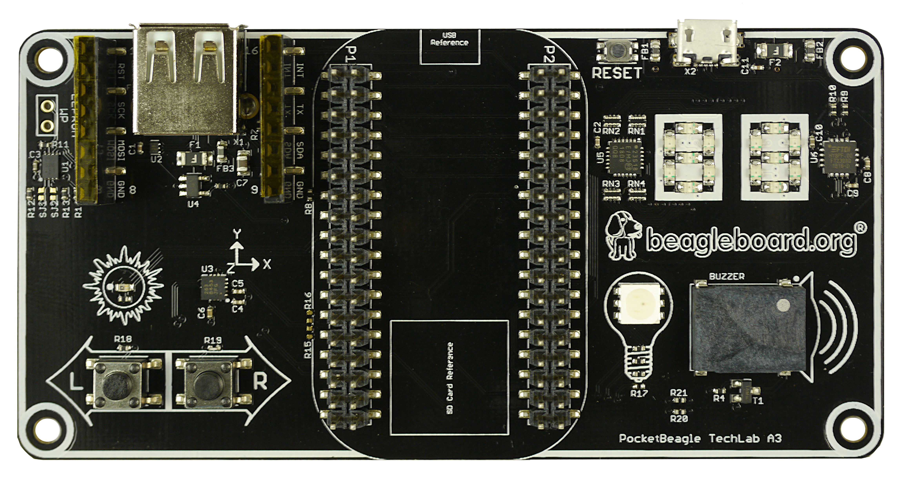
TechLab board image

Slide 34
Developer experience
Customized Debian images – bbb.io/latest
Self-hosted tools for ARMs (A8/M3) and PRUs
Libraries for various high-level languages
Scripts for common tasks
Sources for bootloader, device tree, etc.
Servers for network-based development

Slide 35
See labs in the Handouts
No need to program the microSD card
The link is for your reference. This is already done for you.
Do the first 4 labs
“Blink PocketBeagle on-board USRx LED”
“Read a button”
“Read an analog sensor”
“Fade an LED”
I will interrupt with hints and discussion at intervals

Slide 36
Walk me through the getting started process

Slide 37
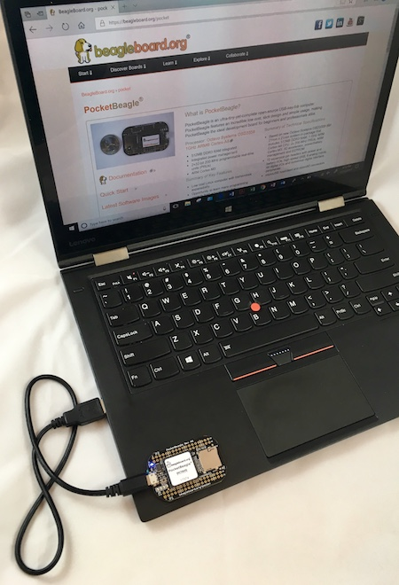
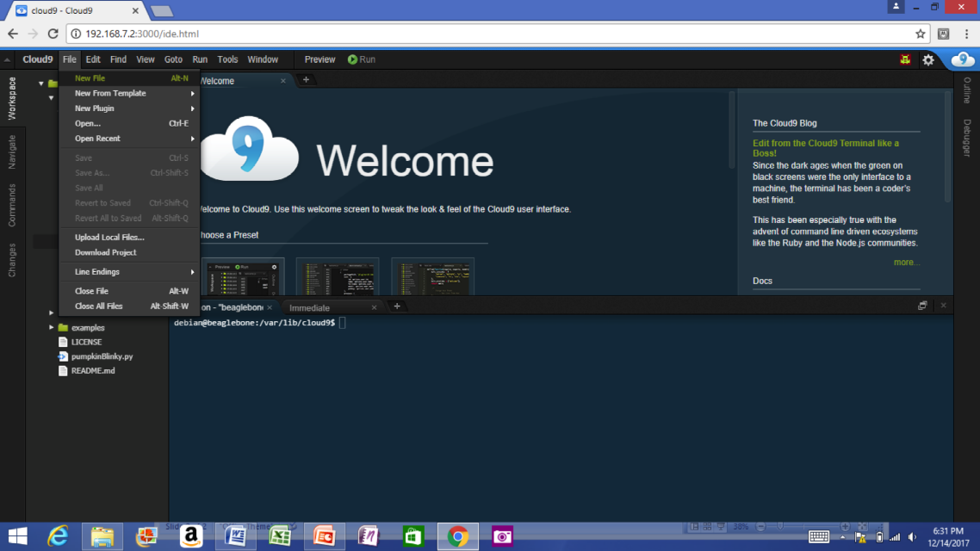
Single cable development
Power, network, develop
You can add a network and power many other ways

Slide 38
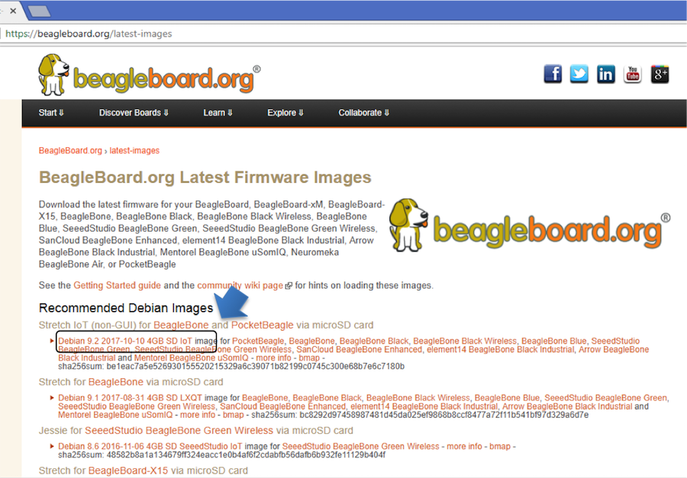
Download image

Slide 39
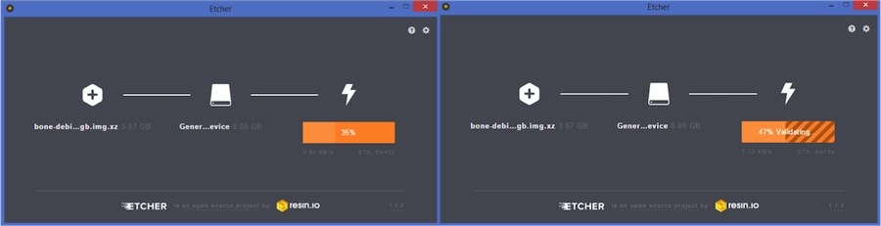
Write image to microSD with Etcher

Slide 40
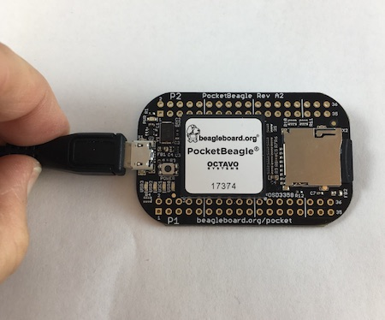
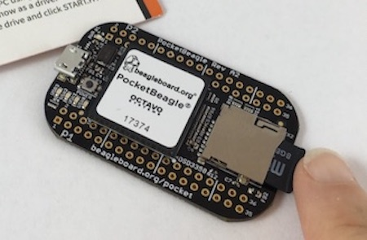
Insert microSD and boot

Slide 41
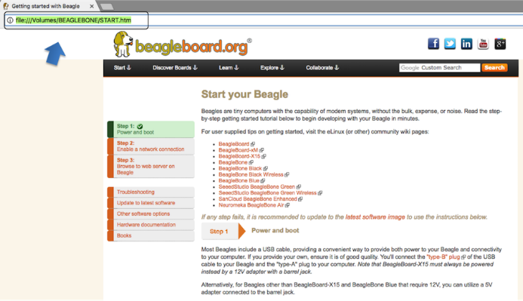
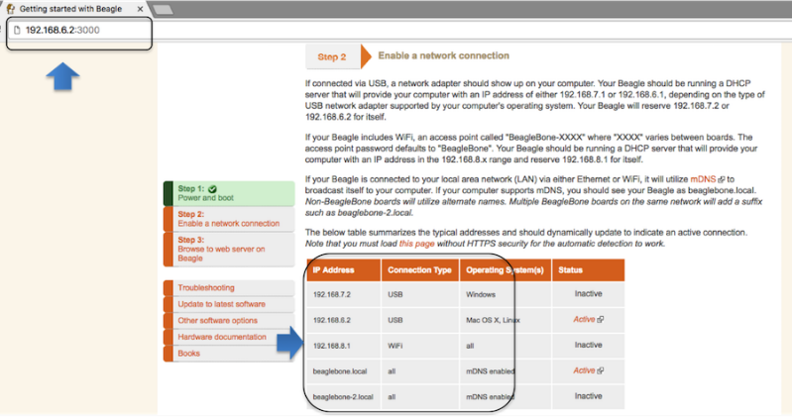
Connect to the USB network

Slide 42
Open the IDE

Slide 43
OK, how is this working?

Slide 44
USB gadgets
Linux name for device/slave drivers
ie., when not host
USB devices have “classes”
Mass storage
Camera
Audio
Printer
“HID” or human-interface device like mouse and keyboard
Communications

Slide 45
USB gadgets
Default image USB gadgets
Virtual mass storage
Serves you up README.htm
Virtual serial
Provides access to console after kernel boot
Virtual network
Enables access to ssh and web servers

Slide 46
Device Tree
See kernel documentation for bindings
devicetree/bindings/eeprom/eeprom.txt
Local copies enable you to extend on the fly
/opt/source/dtb-4.14-ti
/opt/source/bb.org-overlays
Overlays loaded in u-boot, but also possible via kernel configfs

Slide 47
Boot summary
Linux kernel
initramfs
rootfs
/dev /mmcblk0p1
sysboot pins
uSD @128k
uSD @384k
/boot /uEnv.txt
ROM
SPL
UBoot
Device tree
systemd
overlay
service
overlay
service

Slide 48
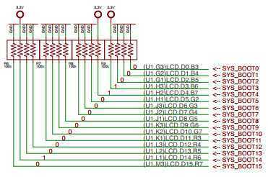
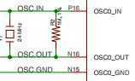
TI AM335x: bootrom
From: (AM335x and AMIC110 Sitara™ Processors Technical Reference Manual (Rev. P))
http://www.ti.com/lit/ug/spruh73p/spruh73p.pdf (page 5032)
SYSBOOT[15:14] = 01 = 24Mhz
SYSBOOT[4:0] = 11000
SPI0
MMC0 - going to use today
USB0 - (node-beagle-boot)
UART0

Slide 49
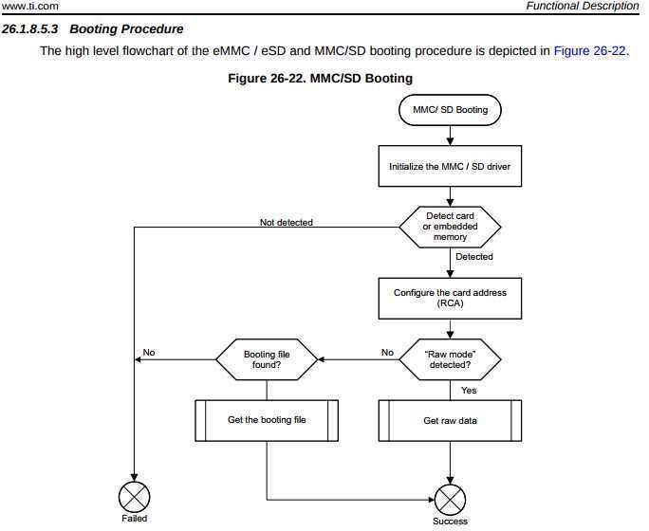
TI AM335x: bootrom
http://www.ti.com/lit/ug/spruh73p/spruh73p.pdf
Page: 5053
MLO

Slide 50
TI AM335x: bootrom: raw mode:
http://www.ti.com/lit/ug/spruh73p/spruh73p.pdf (Page: 5054)
0x0 <- (FAT Boot Sector, let's leave it blank...)
0x20000 (128KB) <- We are going to use this location
0x40000 (256KB) <- (2nd “backup” location)
0x60000 (384KB) <- (3rd “backup” location)
Only 128KB in size… (hint, only 128KB of SRAM)

Slide 51
Das U-Boot (the Universal Boot Loader) U-Boot
Original Author: Wolfgang Denk, now maintained by Tom Rini
https://www.denx.de/wiki/U-Boot
http://git.denx.de/?p=u-boot.git;a=summary
https://en.wikipedia.org/wiki/Das_U-Boot

Slide 52
U-Boot: AM335x
Outputs two files for TI am335x targets:
MLO = SPL (or Secondary Program Loader)
u-boot.img (or u-boot-dtb.img) (U-Boot)
ROM
SPL
UBoot

Slide 53
U-Boot: SPL
Initializes main memory (DDRx for am335x)
Loads full (U-Boot) into DDR memory
Or:
Initializes main memory (DDRx for am335x)
Loads Linux Kernel into DDR memory (aka: Falcon mode, faster boot mode/etc)

Slide 54
U-Boot:
Network
USB
MMC
File System (fat/extX)
Shell
Sometimes you don’t need a full OS, have U-Boot init and then have U-Boot load/run your application.

Slide 55
U-Boot:
CPU : AM335X-GP rev 2.1 I2C: ready DRAM: 512 MiB Some drivers were not found Reset Source: Power-on reset has occurred. MMC: OMAP SD/MMC: 0, OMAP SD/MMC: 1 Using default environment Board: BeagleBone Black <ethaddr> not set. Validating first E-fuse MAC BeagleBone Black: Model: SeeedStudio BeagleBone Green:

Slide 56
U-Boot: microSD
Insert USB-microSD adapter, and type “lsblk”
voodoo@hestia:~/Supercon-2017-PocketBeagle$ lsblk NAME MAJ:MIN RM SIZE RO TYPE MOUNTPOINT sda 8:0 0 465.8G 0 disk └─sda1 8:1 0 465.8G 0 part / sde 8:64 1 7.4G 0 disk └─sde1 8:65 1 7.4G 0 part
Open: system.sh change: MMC=/dev/sde
That’s our 8GB USB Flash Drive

Slide 57
U-Boot: Format microSD
sudo dd if=/dev/zero of=${MMC} bs=1M count=10 sudo sfdisk ${MMC} <<-__EOF__ 4M,,L,* __EOF__ sudo mkfs.ext4 -L rootfs ${MMC}1
voodoo@hestia:~/Supercon-2017-PocketBeagle$ ./scripts/format_drive.sh

Slide 58
U-Boot: (refresh for your memory)
http://www.ti.com/lit/ug/spruh73p/spruh73p.pdf (Page: 5054)
0x0
0x20000 (128KB) <- We are going to use this location
0x40000 (256KB)
0x60000 (384KB)
sudo dd if=./deploy/MLO of=${MMC} count=1 seek=1 bs=128k
sudo dd if=./deploy/u-boot.img of=${MMC} count=2 seek=1 bs=384k

Slide 59
Base Rootfs: Debian 9.x (Stretch)
Maintainer: Robert Nelson (with lots of help from all the Debian Developers and 1000’s of other users)
https://elinux.org/Beagleboard:BeagleBoneBlack_Debian#2017-11-05_-_Debian_9_.28Stretch.29_-_Weekly
https://www.debian.org/
https://github.com/beagleboard/image-builder

Slide 60
See more labs in the Handouts
Do the last 3 labs
“Using Node-RED to read and write files”
“Explore the Linux command line”
“Toggle LED based on a button press using a PRU”
I will interrupt with hints and discussion at intervals

Slide 61
In Linux, everything becomes a file
Much to learn
I'm used to microcontrollers: just give me the datasheet with register definitions and set me free!
Training on boot & device drivers useful
Often geared more at system bring-up
What about the everyday user?
Where is that abstraction benefit?
Let's just walk a working system!

Slide 62
What is the baseline?
http://refspecs.linuxfoundation.org/lsb.shtml
Every Linux system may be customized
This is the nature of open source
Stuff still needs to work together
The Linux Standard Base
Umbrella for various Linux Foundation groups
A specification and a testkit
Documents typical libraries, functions and files expected to be found by the developer

Slide 63
lsb_release
debian@beaglebone:~$ sudo apt install -y lsb debian@beaglebone:~$ lsb_release -a No LSB modules are available. Distributor ID: Debian Description: Debian GNU/Linux 9.5 (stretch) Release: 9.5 Codename: stretch

Slide 64
Filesystem Hierarchy Standard
http://www.pathname.com/fhs/
/tmp: temporary files
/var: data that is changes at run-time
/proc: "information from processes" (virtual)
/sys: "system filesystem" (virtual)
/dev: device files
/media: mount point for removable media
/lost+found: data without directory entry
/mnt: mount point for temporary mounted file systems
/opt: add-on application software packages

Slide 65
/proc
debian@beaglebone:~$ ls /proc 1 1692 22 3354 878 990 fb misc sysvipc 10 17 23 3362 89 apm filesystems modules thread-self 11 18 2370 34 9 asound fs mounts timer_list 1110 1857 2375 4 90 buddyinfo interrupts mtd tty 1112 19 2377 6 91 bus iomem net uptime 1119 1951 2379 69 913 cgroups ioports pagetypeinfo version 1150 1964 24 7 918 cmdline irq partitions vmallocinfo 1151 2 25 70 92 config.gz kallsyms pvr vmstat 1152 20 26 71 93 consoles keys sched_debug zoneinfo 12 21 27 72 945 cpu key-users schedstat 1215 2107 28 73 951 cpuinfo kmsg self 1247 2120 29 74 959 crypto kpagecgroup slabinfo 13 2149 30 8 973 devices kpagecount softirqs 1440 2152 31 800 977 device-tree kpageflags stat 15 2153 32 820 980 diskstats loadavg swaps 159 2155 33 821 983 driver locks sys 16 2173 3353 858 984 execdomains meminfo sysrq-trigger

Slide 66
/proc/cpuinfo
debian@beaglebone:~$ cat /proc/cpuinfo processor : 0 model name : ARMv7 Processor rev 2 (v7l) BogoMIPS : 995.32 Features : half thumb fastmult vfp edsp thumbee neon vfpv3 tls vfpd32 CPU implementer : 0x41 CPU architecture: 7 CPU variant : 0x3 CPU part : 0xc08 CPU revision : 2 Hardware : Generic AM33XX (Flattened Device Tree) Revision : 0000 Serial : 1741GPB42934

Slide 67
The file interface abstraction
What can I do with files?
open, read, write, close, delete
What is an "ioctl"?
What is "mmap"?
What is a virtual file system?
Looks like a file, but executes code in the kernel
Not really storing anything to media
A bit like a "ram disk"

Slide 68
Kernel.org documentation
http://www.kernel.org/doc/
Documentation extracted from the Linux kernel and mirrored on the web where Google can find it:
Documentation - Text files in the kernel source tarball's Documentation subdirectory
htmldocs - Kernel Documentation maintained in docbook format (output of "make htmldocs")
Menuconfig - help text for each kernel configuration option (from kconfig source)
README various README files scattered around Linux kernel source
RFC - List of IETF RFCs referred to by kernel source files. Links to both the text of the RFC and the source files that refer to it
Output of kernel's "make help"
Standards documents applicable to the Linux kernel
Other web pages containing kernel documentation
Translations to other languages
Documentation on memory management
Miscellaneous

Slide 69
Kernel Application Binary Interface
http://www.kernel.org/doc/Documentation/ABI/
Low-level kernel interface from "userland"
Status of interface
Stable
Encouraged to use freely
Guaranteed for at least two years
Testing
Mostly complete, but might change
Let developers know how you are using
Where you’ll find most of the good stuff
Obsolete
Scheduled for removal
Removed

Slide 70
Kernel Application Binary Interface
http://www.kernel.org/doc/Documentation/ABI/
Types of interfaces
Syscalls
Trap interface with IDs
May be possible to have a direct entry
SYSFS
Virtual file system
See also DEBUGFS and CONFIGFS

Slide 71
Syscalls
http://www.kernel.org/doc/man-pages/online/pages/man2/syscalls.2.html
open/read/write/lseek/close/unlink
ioctl
mknod
fork/select/poll/...
mkdir/...
mount/umount
mmap

Slide 72
What is SYSFS?
Virtual file system that exposes drivers to userspace
mount
sysfs on /sys type sysfs (rw,nosuid,nodev,noexec,relatime)
/sys/devices - driver hierarchy
/sys/bus - symbolic links to bus owners
/sys/class - common interfaces
/sys/block - block interface
How about some examples?

Slide 73
/sys/module
http://www.kernel.org/doc/Documentation/ABI/stable/sysfs-module
/sys/module/MODULENAME
.../parameters: options you can provide
.../refcnt: number of times in use
debian@beaglebone:~$ ls /sys/module 8250 fb lockd pruss sysrq usb_f_ecm apparmor firmware_class mma8452 pruss_intc tcp_cubic usb_f_mass_storage auth_rpcgss fscrypto mmcblk pruss_soc_bus tda18271 usb_f_rndis block fuse module pvrsrvkm tda827x usbhid bone_capemgr hid mt20xx r8188eu tda8290 usb_storage can hid_logitech netpoll random tda9887 u_serial cec hid_logitech_hidpp nf_conntrack rc_core tea5761 vt cfg80211 i2c_algo_bit nf_conntrack_ipv4 rcupdate tea5767 watchdog configfs ima nf_defrag_ipv4 rcutree ti_cpsw wireguard cpufreq iptable_filter nf_nat rfkill tpm workqueue cpuidle iptable_mangle nf_nat_ipv4 rng_core tuner_simple xc4000 cryptomgr iptable_nat nfs scsi_mod tuner_xc2028 xc5000 dns_resolver ip_tables nfs_layout_nfsv41_files sdhci ubi xhci_hcd drm ipv6 nfsv4 snd ubifs x_tables drm_kms_helper ir_kbd_i2c omapdrm snd_pcm udl xz_dec dvb_core kernel omap_mailbox snd_timer u_ether zswap dynamic_debug keyboard onenand spidev uinput eeprom_93cx6 leds_pwm overlay spurious uio ehci_hcd libahci pinctrl_mcp23s08 srcutree uio_pdrv_genirq etnaviv libata printk sunrpc usbcore evdev libcomposite pru_rproc suspend usb_f_acm

Slide 74
/sys/class/leds
https://www.kernel.org/doc/Documentation/ABI/testing/sysfs-class-led
/sys/class/leds/LED
.../brightness: 0-max_brightness, >0 = on
.../max_brightness: default is 255
.../trigger: triggers available from kernel
.../inverted: invert on/off state
debian@beaglebone:~$ ls /sys/class/leds beaglebone:green:usr0 techlab::blue techlab::seg1 techlab::seg13 techlab::seg3 techlab::seg7 beaglebone:green:usr1 techlab::green techlab::seg10 techlab::seg14 techlab::seg4 techlab::seg8 beaglebone:green:usr2 techlab::red techlab::seg11 techlab::seg15 techlab::seg5 techlab::seg9 beaglebone:green:usr3 techlab::seg0 techlab::seg12 techlab::seg2 techlab::seg6

Slide 75
/sys/class/gpio
http://www.kernel.org/doc/Documentation/ABI/testing/sysfs-gpio
Must be explicitly exported to userspace and not claimed by kernel code
/sys/class/gpio
.../export: asks the kernel to export a GPIO to userspace
.../unexport: to return a GPIO to the kernel
.../gpioN: for each exported GPIO #N
.../value: always readable, writes fail for input GPIOs
.../direction: r/w as: in, out (low); write: high, low
.../edge: r/w as: none, falling, rising, both
.../gpiochipN:for each gpiochip; #N is its first GPIO
.../base: (r/o) same as N
.../label: (r/o) descriptive, not necessarily unique
.../ngpio: (r/o) number of GPIOs; numbered N to N + (ngpio - 1)
debian@beaglebone:~$ ls /sys/class/gpio export gpio114 gpio13 gpio20 gpio30 gpio42 gpio47 gpio58 gpio7 gpiochip0 unexport gpio110 gpio115 gpio14 gpio23 gpio31 gpio43 gpio5 gpio59 gpio86 gpiochip32 gpio111 gpio116 gpio15 gpio26 gpio4 gpio44 gpio50 gpio60 gpio87 gpiochip496 gpio112 gpio117 gpio19 gpio27 gpio40 gpio45 gpio52 gpio64 gpio88 gpiochip64 gpio113 gpio12 gpio2 gpio3 gpio41 gpio46 gpio57 gpio65 gpio89 gpiochip96

Slide 76
On-chip peripherals (OCP)
debian@beaglebone:~$ ls /sys/devices/platform/ocp 40300000.ocmcram 480c8000.mailbox 53100000.sham ocp:P1_32_pinmux ocp:P2_20_pinmux 44e07000.gpio 480ca000.spinlock 53500000.aes ocp:P1_33_pinmux ocp:P2_22_pinmux 44e09000.serial 4819c000.i2c 56000000.sgx ocp:P1_34_pinmux ocp:P2_24_pinmux 44e0b000.i2c 481a0000.spi driver_override ocp:P1_35_pinmux ocp:P2_25_pinmux 44e0d000.tscadc 481a8000.serial modalias ocp:P1_36_pinmux ocp:P2_27_pinmux 44e35000.wdt 481ac000.gpio ocp:cape-universal ocp:P2_01_pinmux ocp:P2_28_pinmux 44e3e000.rtc 481ae000.gpio ocp:l4_wkup@44c00000 ocp:P2_02_pinmux ocp:P2_29_pinmux 47400000.usb 481cc000.can ocp:P1_02_pinmux ocp:P2_03_pinmux ocp:P2_30_pinmux 48022000.serial 481d0000.can ocp:P1_04_pinmux ocp:P2_04_pinmux ocp:P2_31_pinmux 48024000.serial 48300000.epwmss ocp:P1_06_pinmux ocp:P2_05_pinmux ocp:P2_32_pinmux 4802a000.i2c 48302000.epwmss ocp:P1_08_pinmux ocp:P2_06_pinmux ocp:P2_33_pinmux 48030000.spi 48304000.epwmss ocp:P1_10_pinmux ocp:P2_07_pinmux ocp:P2_34_pinmux 48042000.timer 48310000.rng ocp:P1_12_pinmux ocp:P2_08_pinmux ocp:P2_35_pinmux 48044000.timer 49000000.edma ocp:P1_20_pinmux ocp:P2_09_pinmux of_node 48046000.timer 49800000.tptc ocp:P1_26_pinmux ocp:P2_10_pinmux power 48048000.timer 49900000.tptc ocp:P1_28_pinmux ocp:P2_11_pinmux subsystem 4804a000.timer 49a00000.tptc ocp:P1_29_pinmux ocp:P2_17_pinmux uevent 4804c000.gpio 4a326004.pruss-soc-bus ocp:P1_30_pinmux ocp:P2_18_pinmux 48060000.mmc 4c000000.emif ocp:P1_31_pinmux ocp:P2_19_pinmux

Slide 77
Reading events
TBD

Slide 78
config-pin
https://github.com/beagleboard/bb.org-overlays - tools/beaglebone-universal-io
debian@beaglebone:~$ config-pin -i p1.36 Pin name: P1_36 Function if no cape loaded: pwm Function if cape loaded: default gpio gpio_pu gpio_pd gpio_input spi_sclk pwm pruout pruin Function information: ehrpwm0a default gpio3_14 gpio3_14 gpio3_14 gpio3_14 spi1_sclk ehrpwm0a pru0_out0 pru0_in0 Kernel GPIO id: 110 PRU GPIO id: 142 debian@beaglebone:~$ config-pin -q p1.36 P1_36 Mode: default Direction: in Value: 0 debian@beaglebone:~$ config-pin p1.36 pruout debian@beaglebone:~$ config-pin -q p1.36 P1_36 Mode: pruout

Slide 79
show-pins.pl
perl /opt/scripts/device/bone/show-pins.pl -v

Slide 80
Enabling PRU
2 possible drivers: remoteproc or uio
Enabled via device tree at boot
Different systems might have different defaults

Slide 81
mikroBus Click usage
See bbb.io/pbmb
Supported with device-tree overlays loaded in u-boot

Slide 82
Some work in progress
Add proxy for various services (in Buster IoT images today)
Integrate common web-based WiFi provisioning
SeeedStudio BealgeBone Green Wireless ships with ‘wifidog’ → we will unify approach
Cross-platform distro installer app
See USB NETCONSOLE presentation
Support for Grove modules and mikroBus clicks
Focus on device-tree overlays and kernel patches
Integration alignment with complete domain solutions
Intelligent Agent Replicape/Revolve, Bela Mini, BeagleLogic, PocketPilot, etc.
Improved and integrated PRU examples
Move to distro friendly approaches for customizations

Slide 83
Contributions and issues
Cape/add-on support
https://github.com/beagleboard/bb.org-overlays
Image deltas
https://github.com/beagleboard/image-builder
In-system examples
https://github.com/beagleboard/bone101

Slide 84
Questions?

Slide 85
Thank you!

